Slide 1


PLAYFAIR CIPHER TECHNIQUE
PRESENTED BY
KESHAVARAM L (192511253)
GUIDED BY
Dr. E.ANBALAGAN

Slide 2
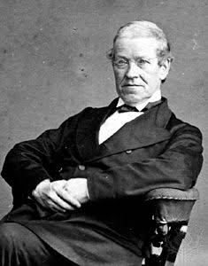
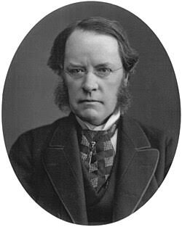
INTRODUCTION
The Playfair Cipher is a manual symmetric encryption technique.
It was invented by Charles Wheatstone in 1854.
It was promoted by Lord Playfair, after whom it is named.
It encrypts pairs of letters (digraphs) instead of single letters.
It provides better security than the Caesar Cipher and Monoalphabetic Cipher.
Sir Charles Wheatstone
Sir Lord Playfair

Slide 3
Encrypt using these rules:
Same row → Take the next letter to the right.
Same column → Take the letter below.
Rectangle → Replace each letter with the letter in the same row but the other letter's column.
Aim:
To securely encrypt and decrypt text using pairs of letters
Algorithm
Choose a keyword.
Create a 5 × 5 matrix using the keyword.
Combine I and J into one cell.
Fill the remaining letters of the alphabet
Divide the plaintext into pairs.
Insert X if two letters in a pair are the same.

Slide 4
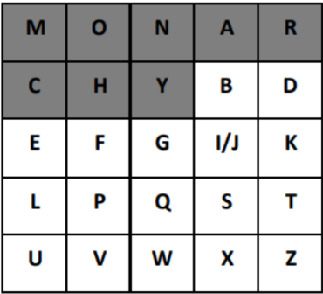
EXAMPLE
Plaintext : HELLO
Split into pairs : HE LX LO
Encryption
HE → CF
LX → SU
LO → PM
CFSUPM

Slide 5
ADVANTAGES
More secure than simple substitution ciphers.
Encrypts two letters at a time.
Easy to implement manually.
Reduces frequency analysis attacks.
No complex calculations.
DISADVANTAGES
Limited to a 5×5 matrix. I and J are combined.
Vulnerable to modern cryptanalysis.
Slower for long messages.
Not suitable for today's secure communication.

Slide 6
APPLICATIONS
Military communication (historically).
Educational cryptography .
Learning encryption techniques .
Puzzle and coding competitions.

